Slide 1



Marketing Campaigns (phone calls) of a Portuguese Banking Institution
View in Power BI
Last data refresh:
10/29/2024 8:38:00 AM UTC
Downloaded at:
10/29/2024 9:21:42 AM UTC

Slide 2
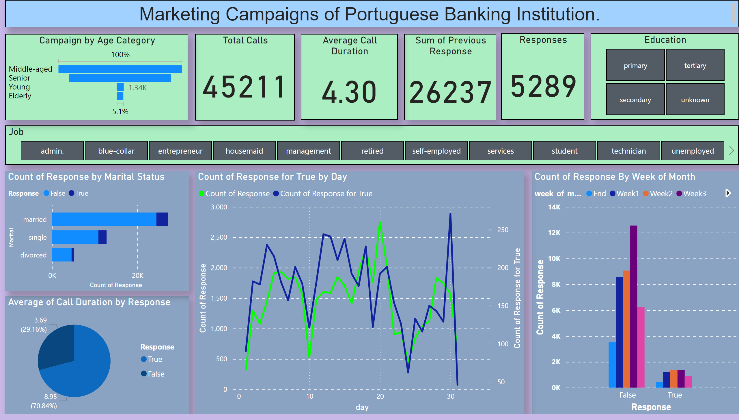
Page 1
Notes:
textbox
No alt text provided
Total Calls
No alt text provided
Sum of Previous Response
No alt text provided
Responses
No alt text provided
Education
No alt text provided
Job
No alt text provided
Campaign by Age Category
No alt text provided
Average of Call Duration by Response
No alt text provided
Count of Response by Marital Status
No alt text provided
Count of Response By Week of Month
No alt text provided
Count of Response for True by Day
No alt text provided
Average Call Duration
No alt text provided

